Slide 1



FARM 2 TABLET
The best recipes in the palm of your hand

Slide 2

The Pitch
Today’s foodie is as concerned with where their food comes from as how it tastes. They want a product that is pleasing to the tongue, to the eye, and to the conscience. And, it never hearts to finish things off with something strong to wash it down. That’s why FARM 2 TABLET brings all of these options together in a convenient application.

Slide 3
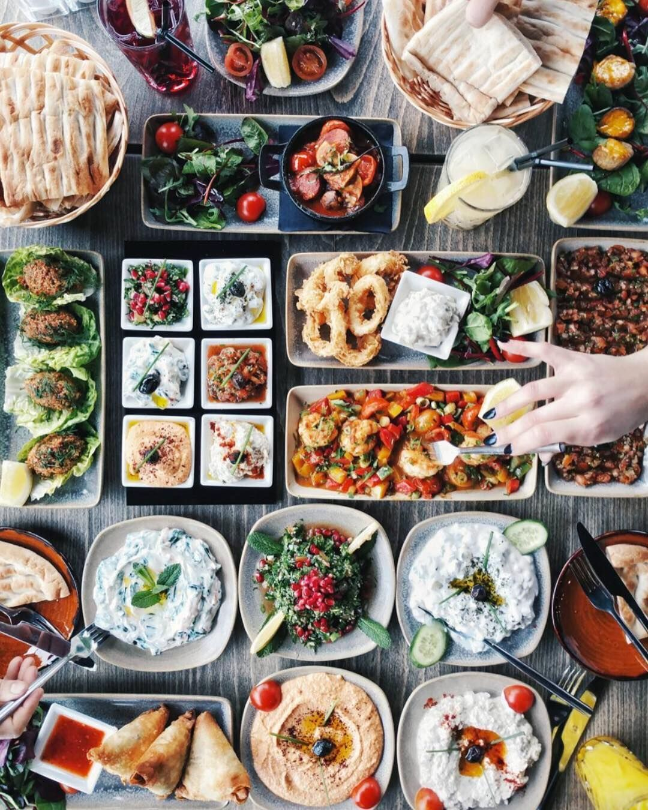
Concept Overview
Our application FARM 2 TABLET is the search engine of choice for millennials who are sick and tired of the same-old meals, but too lazy to spend more than a minute figuring out the next recipe to try out.
Powered by the Spoonacular API, the FARM 2 TABLET team has built a leading-edge search engine that helps users to find the perfect recipe through everyday clutter.
Because no meal is complete without a stiff drink, FARM 2 TABLET also takes advantage of the Cocktail DB’s drink API to produce the perfect pairing of alcoholic drink to your food selection.
FARM 2 TABLET was built by foodies for foodies in order to save the world from the atrocities of bland, frozen meals.
“As a busy foodie, I want to quickly and effortlessly choose a meal recipe based on my preferences, so that I can save time searching for recipes that work for me.”

Slide 4



Process Overview
Server-side APIs
Spoonacular
The Cocktail DB
Third-Party API - React
CSS framework – Materialize
Challenges:
Randomized calls
Undefined queries
API call limitations
Responsible for drink-pairing and project coordination.
Responsible for recipe search and branding.
Responsible for site architecture and element layout.

Slide 5
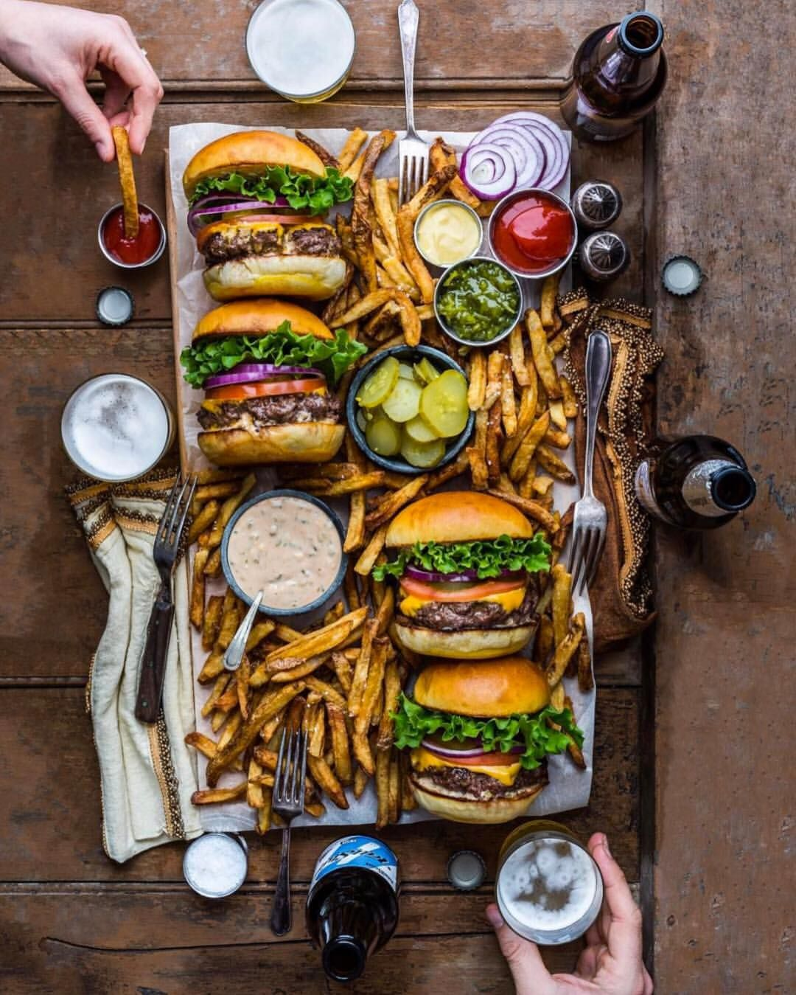
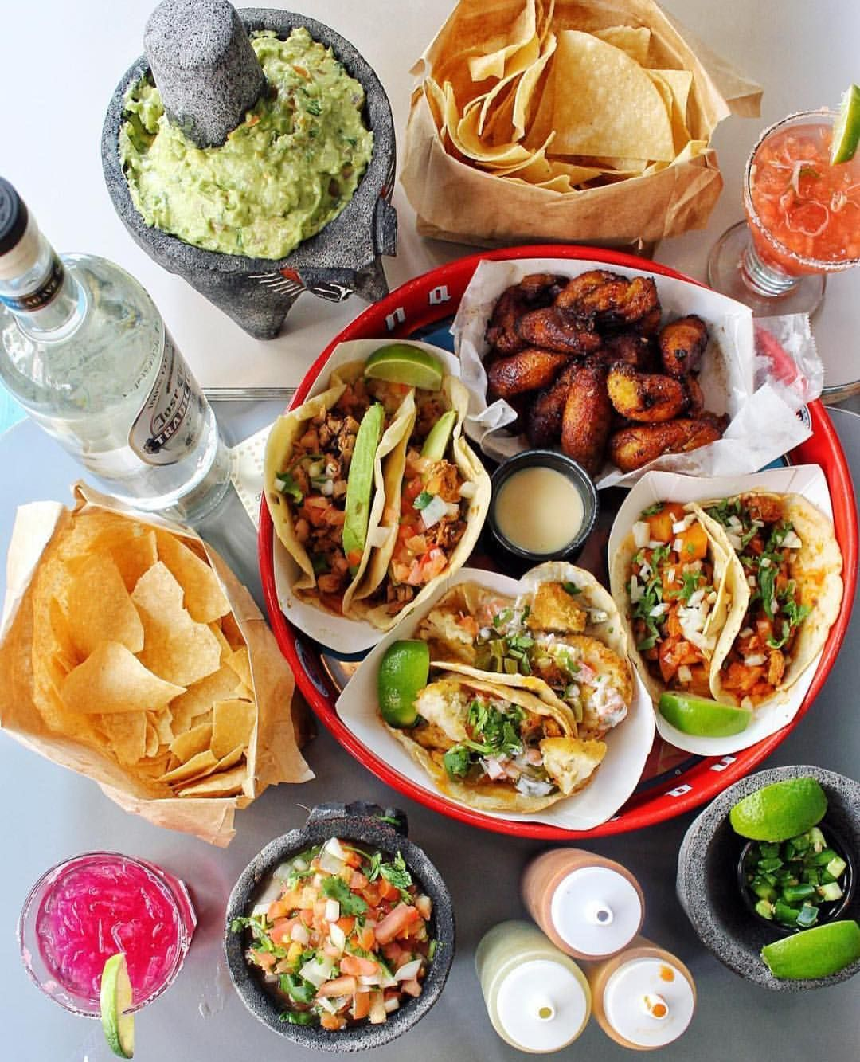
Product Demo

Slide 6
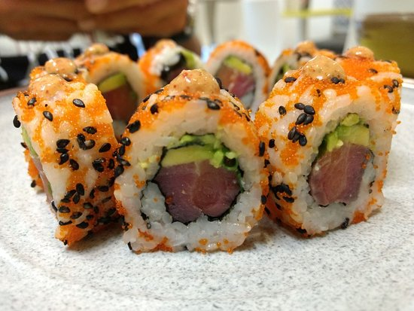
What’s Next?
The next steps for development are to widen the menu of options available through FARM 2 TABLET and allow for recipes to be hosted directly on our website. The team has considered increasing the number of inputs for the survey as well to even better match recipes to our famished foodies.

Slide 7
Product Links
ADD IN DEPLOYED LINK HERE
https://github.com/MJP1986/projectone

